Slide 1

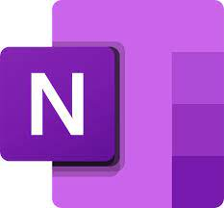
OneNote for them all!
Notes:
Have slide 1 displaying as participants enter the session and get settled.

Slide 2

Meet your trainer
Stevie Frank
Technology Integration Specialist grades K-8,
Masters in Reading Education, Professional Learning Specialist, Education Week’s Top 30 Influencers
@StevieFrank23
@MicrosoftEDU
Notes:
Tip: To make your photo round, select the photo, then on the right side of the ribbon is a drop-down “crop” tool. Choose Crop to Shape and select the circle.
Say: I am ____ and I ________ (introduce yourself and share your background with the audience).
Note: If you have a moderator on your call, be sure to introduce him/her/them as well.

Slide 3
Instructional Cycle
Assessing
Reflecting
Adjusting
Planning
Notes:
Say: Teachers are in a constant cycle of instructional planning, assessing, reflecting, and adjusting based on whole-class and individual student needs.

Slide 4


The Digital Trapper Keeper:

Slide 5
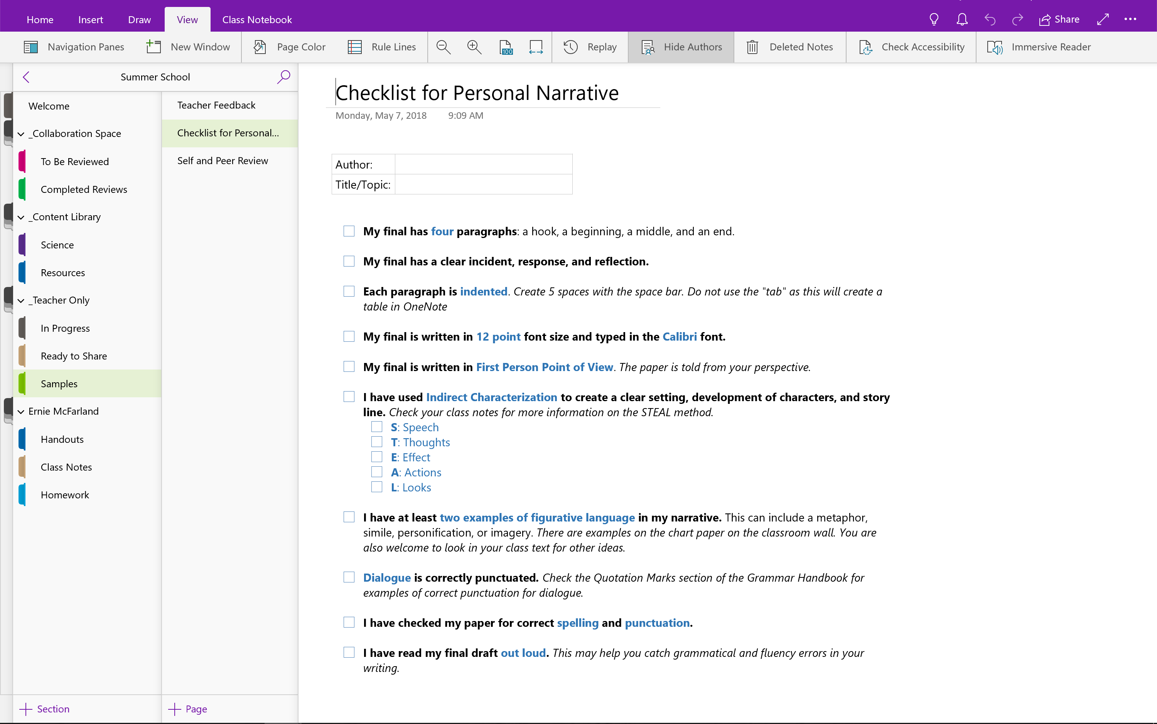
Notes:
Say: But now, in my Teacher-Only section of OneNote Class Notebook, I have alternate assignments and resources organized and ready to use whenever needed. With just a few clicks, I select a page, select a section, and distribute the resources to my students. Done! My students don't even have to wait for me to pass out any papers.
Plus, students don't feel singled out by getting "extra" work that their classmates don't also have assigned to them. They know that their assignments are designed specifically for their learning needs and are delivered to their student private notebooks without their peers knowing they have something different.
This kind of instructional efficiency has changed the way I organize my instructional materials and plan my lessons.

Slide 6
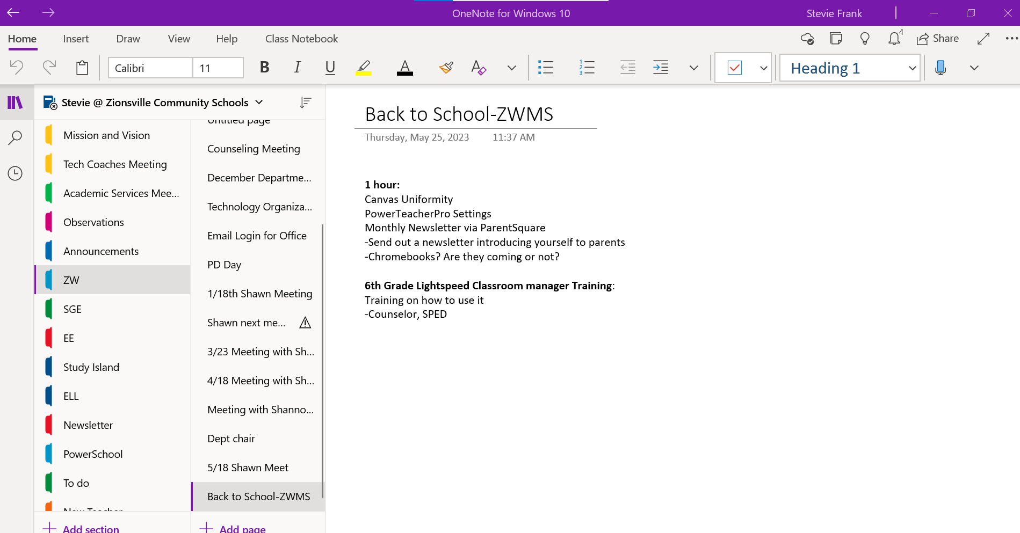
How I use it as a tech coach:

Slide 7
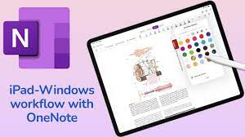
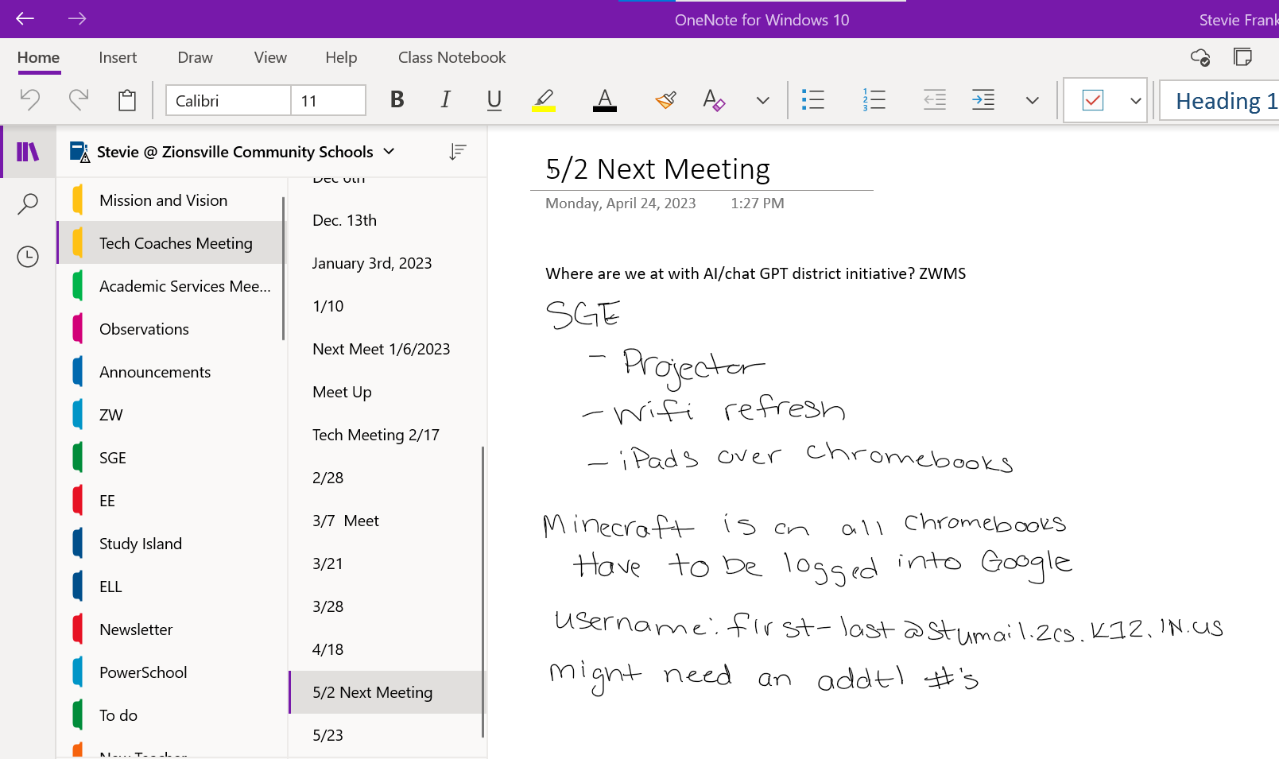
How I use it as a tech coach:

Slide 8
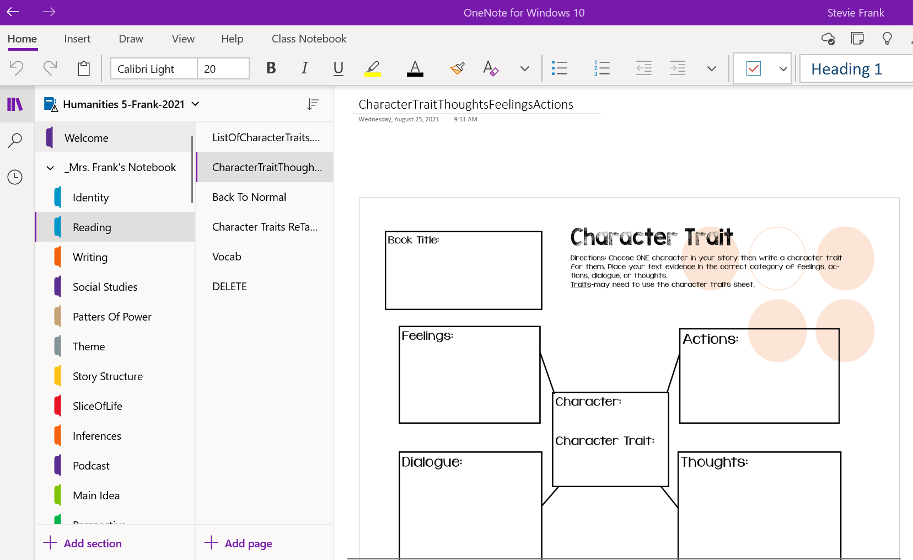
How I used it in the classroom:

Slide 9
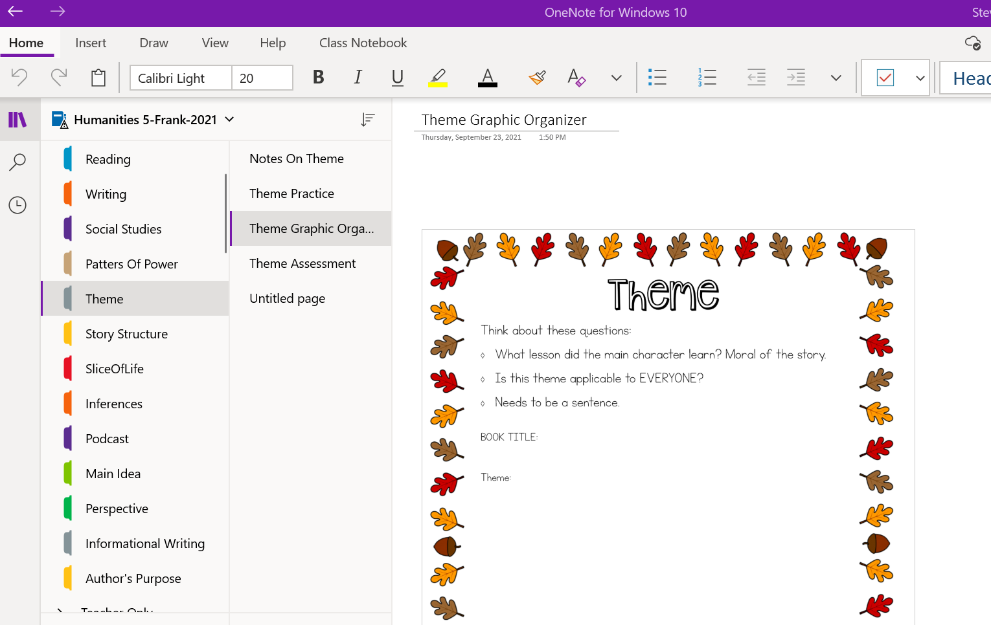
How I used it in the classroom:

Slide 10
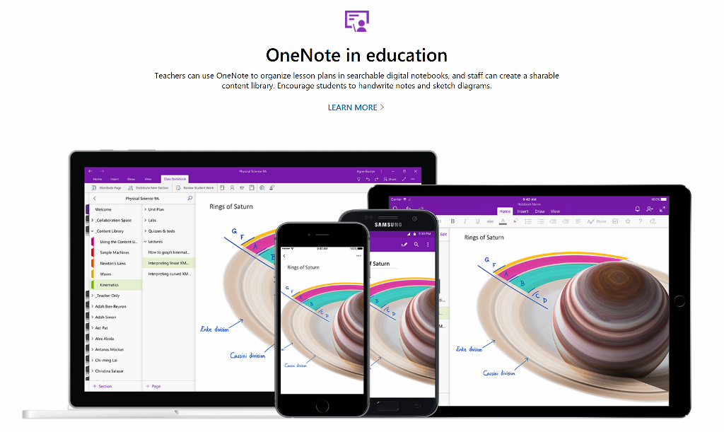
https://products.office.com/en-US/onenote
Notes:
Scroll through the images on https://products.office.com/en-US/onenote

Slide 11
DEMO
Use this section of slides if live demo is not available

Slide 12
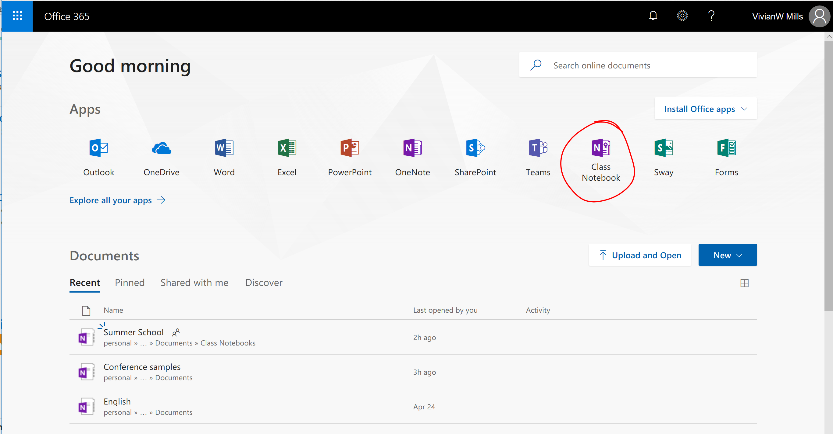
Notes:
Live demo...keep it quick
Say: You create Class Notebooks through Office 365 or through Microsoft Teams. We'll hear more about Teams later. For now, let me briefly show the quick process to create a Class Notebook in Office 365.
Do: Log into Office 365 and click through (quickly) the Class Notebook set-up tool just so participants see all the steps. If not doing live demo, click through the slide deck to briefly show the steps.
This is not designed for "stop and ask questions" but just a quick view of the steps.

Slide 13
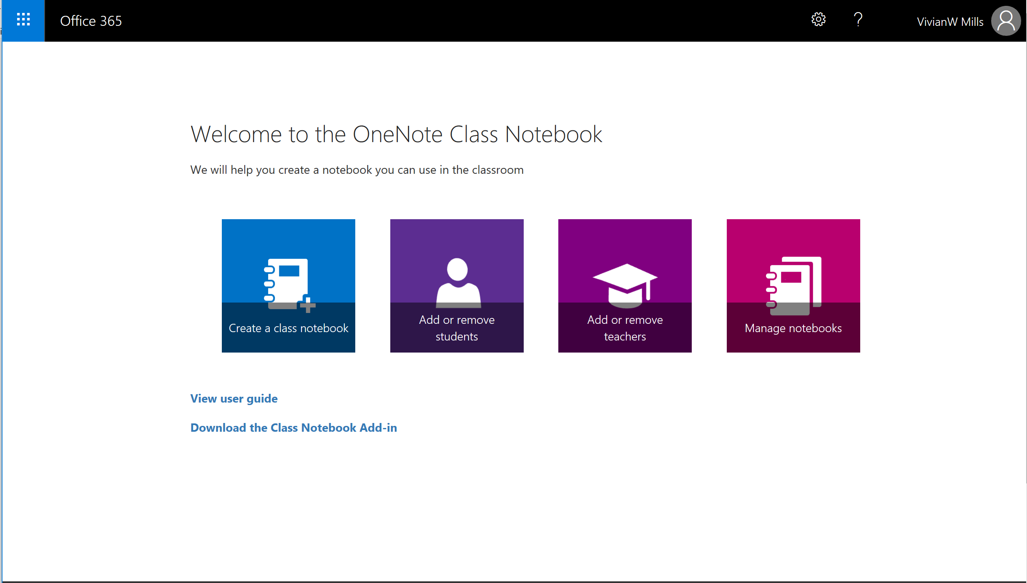

Notes:
Say: In the Office 365 portal, I select Class Notebook then Create a class notebook.
Do: Advance to the next step.

Slide 14
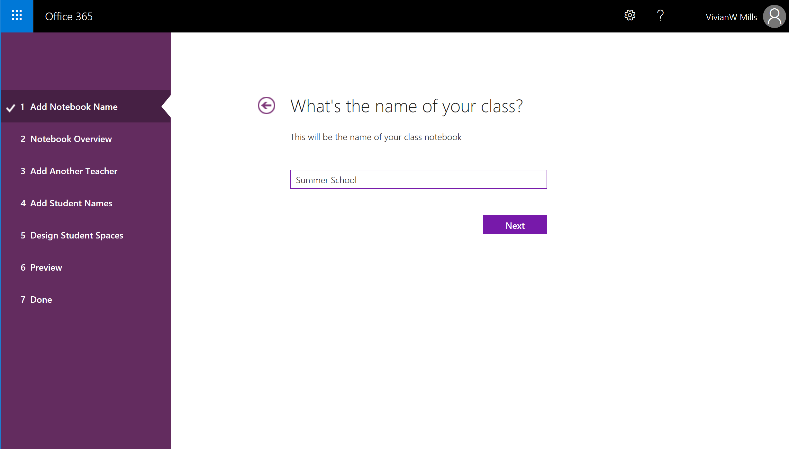
Notes:
Say: The process is complete in just 7 easy steps. First, I name the notebook.
Do: Advance to the next step.

Slide 15
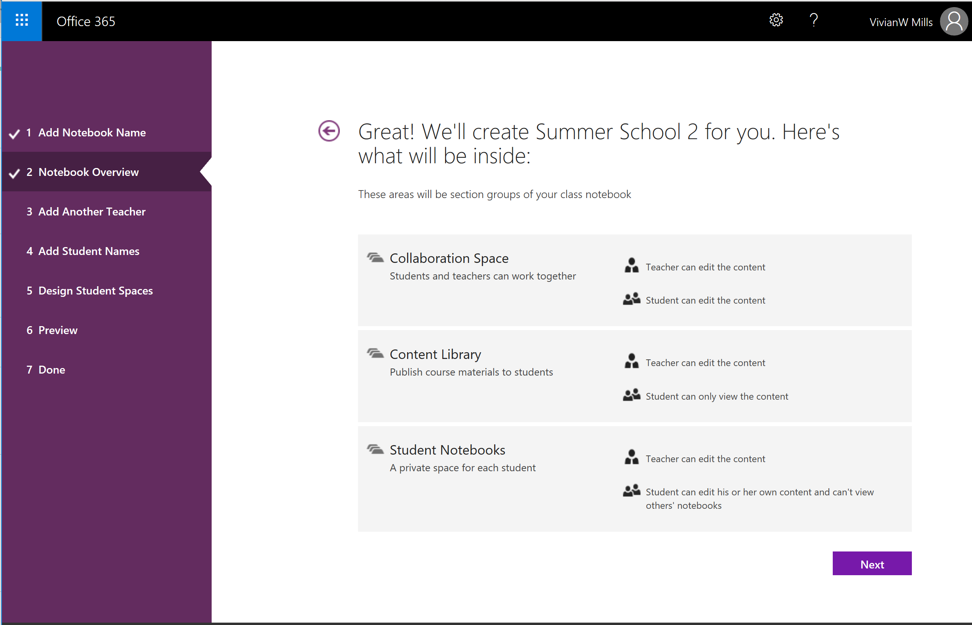
Notes:
Say: Next, I see the structure of the notebook with 3 distinct areas: Collaboration Space, Content Library, and Student Notebooks.
Do: Advance to the next step.

Slide 16
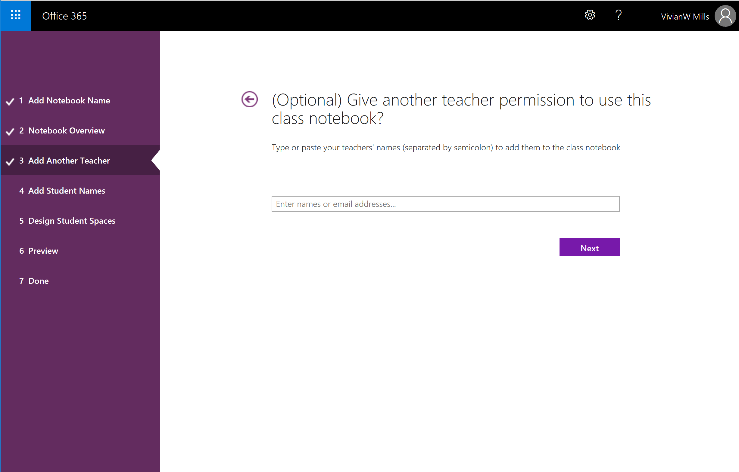
Notes:
Say: I can add another teacher if needed.
Do: Advance to the next step.

Slide 17
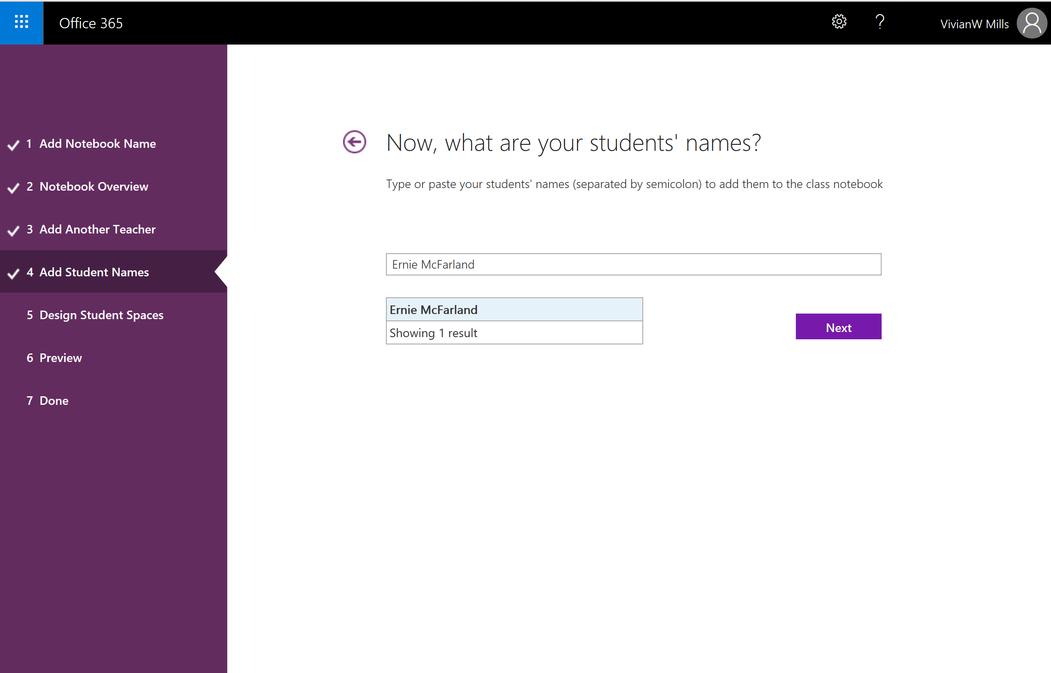
Notes:
Say: Next, I'm prompted to add students. I often skip this step now and add students later. I like to build the structure of the Class Notebook before I invite them to it.
Do: Advance to the next step.

Slide 18
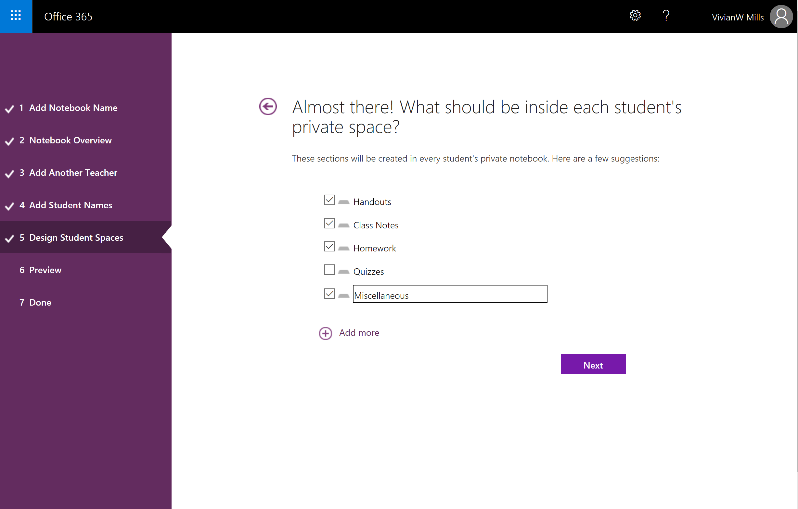
Notes:
Say: Even if I don't add students now, in the next step I can still determine how to personalize the default sections of my students' notebooks. I can use the suggested sections or add others.
Do: Advance to the next step.

Slide 19
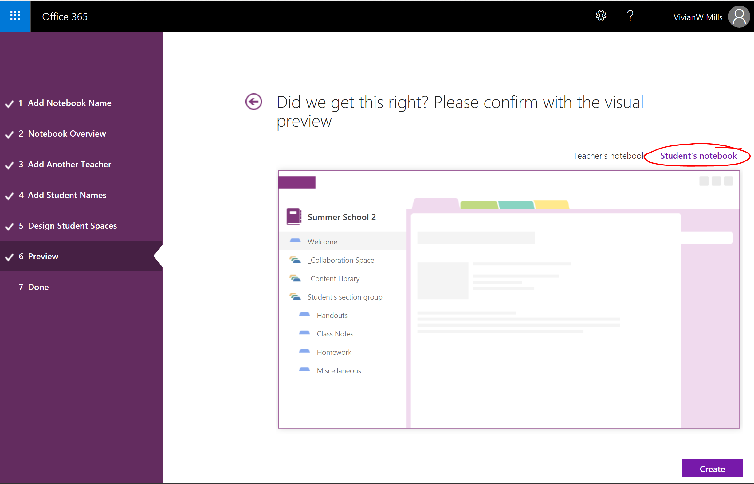
Notes:
Say: The next step previews the teacher and student spaces before I finish and create the notebook.
Do: *Don't finish creating the notebook. Instead, you'll use the notebook you opened previously (see "Before you teach" notes).
Say: And, that's it! Once the Class Notebook is created, I can start working in it with any version of OneNote including OneNote Online and OneNote for Windows 10. Today, I'll choose OneNote for Windows 10.
Do: Go back to OneNote for Windows 10 and navigate to the Content Library in the sample Class Notebook.

Slide 20
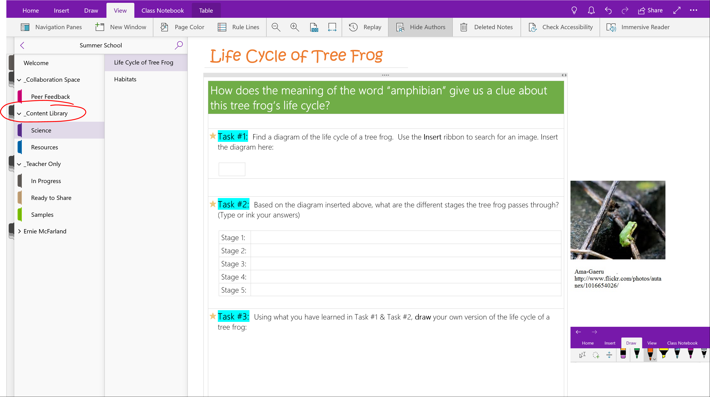
Notes:
Say: OneNote allows teachers to store information in various multimedia formats so that students have one-stop shopping for curricular content that the teacher can predetermine. When building a new Class Notebook, I often start in the Content Library. It is a convenient place to store resources for students that students cannot edit. It is a read-only section.
Do: Display the "Life Cycle of a Tree Frog" page in the Content Library.
Say: Often, I use the Content Library for resources I want to students to access for a lesson or unit. For example, I might have pages with reading material, task lists, and tables of web resources. I hear from many teachers that instead of spending oodles of time at the copy machine, they just build student activities in the Content Library.

Slide 21
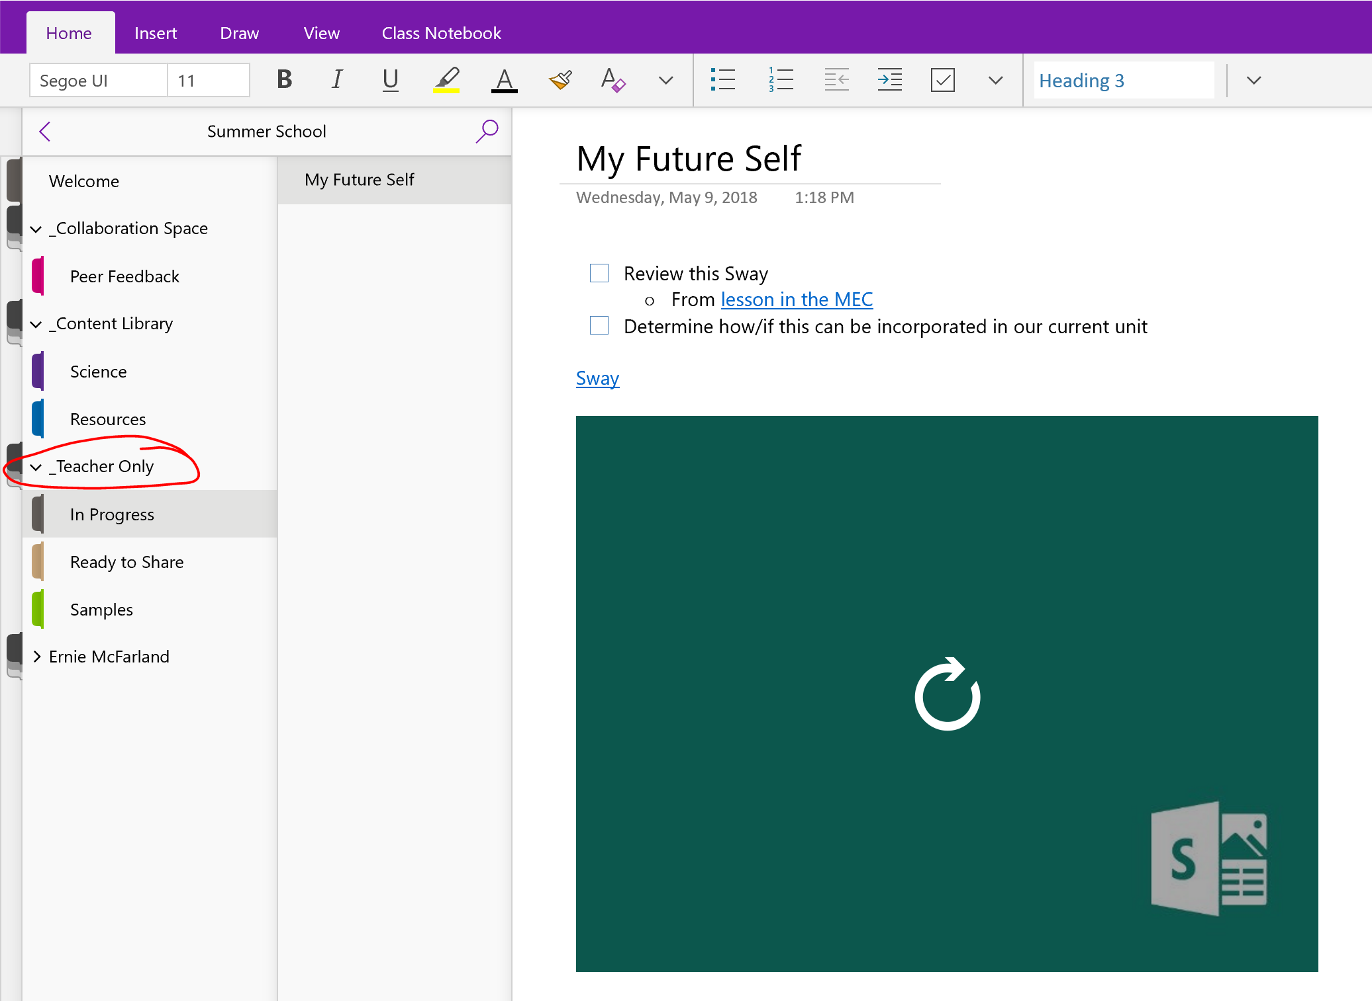
Notes:
Say: Sometimes I need to organize my instructional content before I'm ready for students to see it. The Teacher-Only section is perfect for that. It's a place where I can draft my work and then move or copy pages to the Content Library when I'm ready for students to view the content. To enable to the Teacher-Only section, go back to Office 365 and select Manage Class Notebooks.

Slide 22
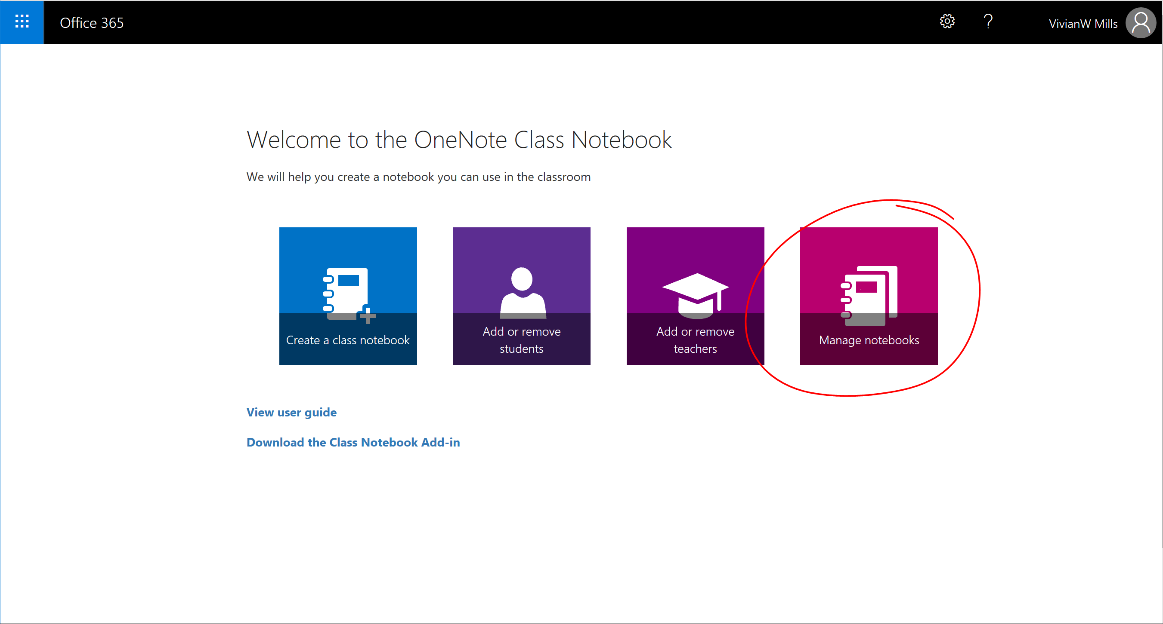

Slide 23
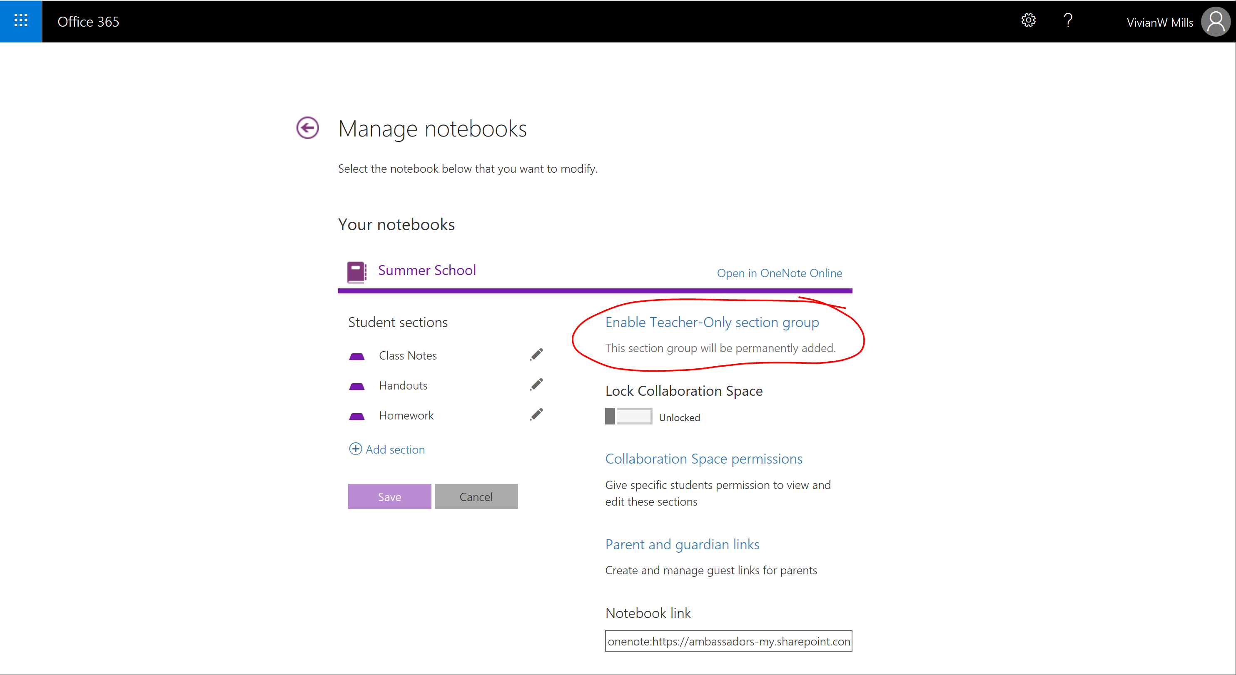

Slide 24
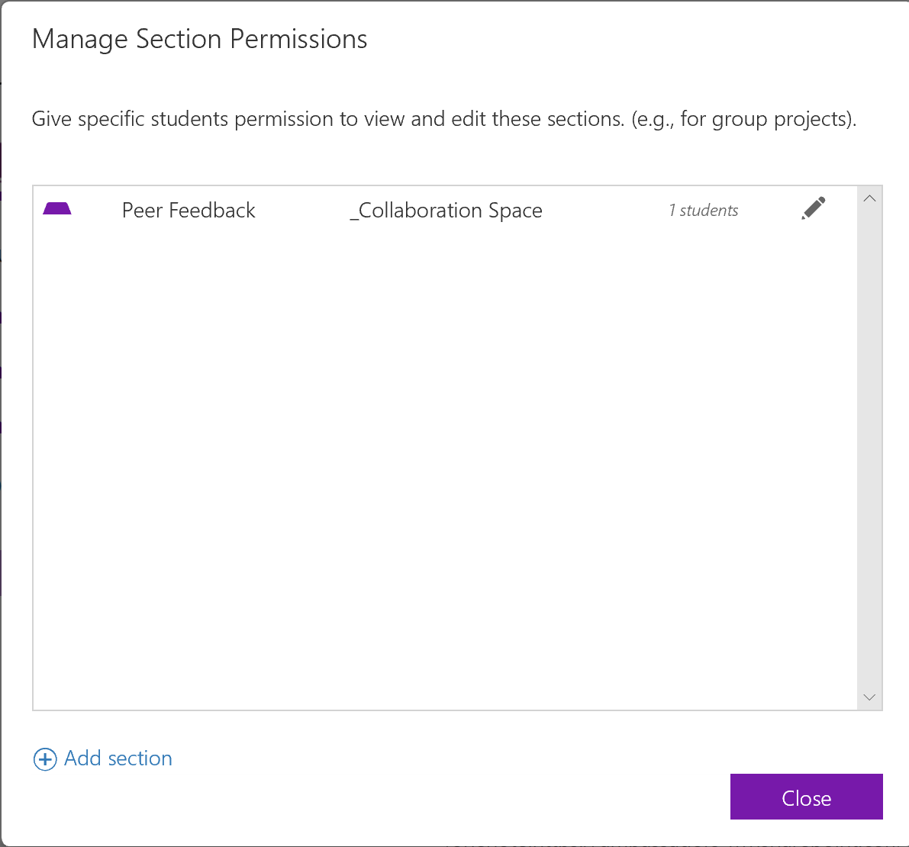
Collaboration Space permissions
Notes:
When in the Manage Notebook panel, you can specific which students can view which sections.
This is especially useful when you have groups of students working on different projects and you don’t need the entire class to have access to all the group sections.

Slide 25
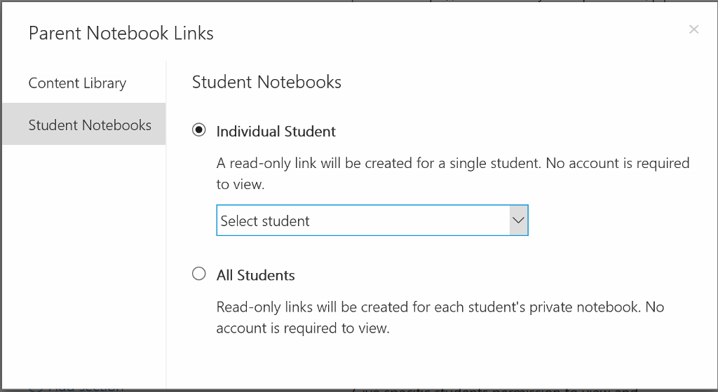
Parent and Guardian links
Notes:
When in the Manage Notebook panel, you can specific which students can view which sections.
This is especially useful when you have groups of students working on different projects and you don’t need the entire class to have access to all the group sections.

Slide 26
DEMO
Use this section of slides if live demo is not available

Slide 27
How do you use OneNote with students?
Which features of OneNote Class Notebook are you excited to try out with your students?
Notes:
Say: Let's get some shout-outs before we wrap-up.
Ask: How do you use OneNote with students? Which features of OneNote Class Notebook are you excited to try out with your students?
Do: Take as many responses as possible with the remaining time.
Say: Thank you for attending. I hope you enjoy the rest of the conference!
Do: Display final slides

Slide 28
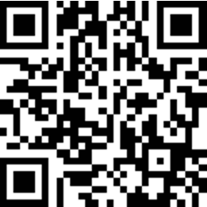
Get a copy of this presentation to share with others!
aka.ms/OneNotebooktoRuleThemAll

